Slide 1
CS525: Special Topics in DBs Large-Scale Data Management
HBase
Spring 2013 WPI, Mohamed Eltabakh

Slide 2

HBase: Overview
HBase is a distributed column-oriented data store built on top of HDFS
HBase is an Apache open source project whose goal is to provide storage for the Hadoop Distributed Computing
Data is logically organized into tables, rows and columns

Slide 3
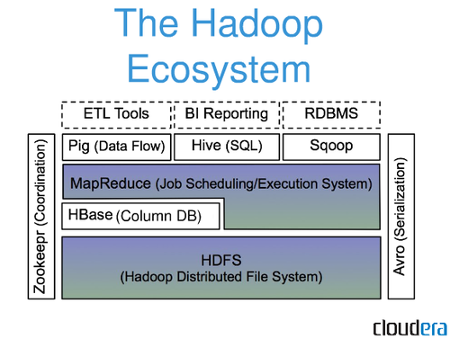
HBase: Part of Hadoop’s Ecosystem
HBase is built on top of HDFS
HBase files are internally stored in HDFS

Slide 4
HBase vs. HDFS
Both are distributed systems that scale to hundreds or thousands of nodes
HDFS is good for batch processing (scans over big files)
Not good for record lookup
Not good for incremental addition of small batches
Not good for updates

Slide 5
HBase vs. HDFS (Cont’d)
HBase is designed to efficiently address the above points
Fast record lookup
Support for record-level insertion
Support for updates (not in place)
HBase updates are done by creating new versions of values

Slide 6
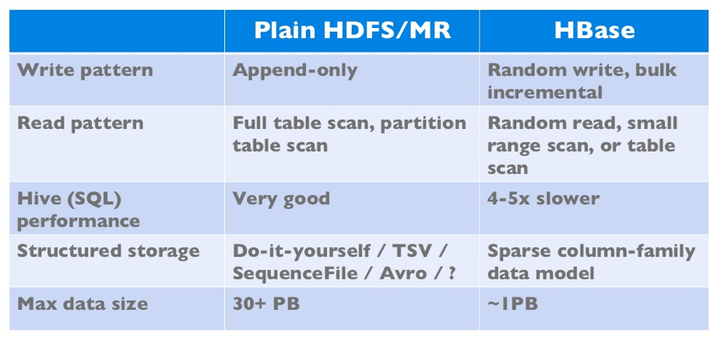
HBase vs. HDFS (Cont’d)
If application has neither random reads or writes ➔ Stick to HDFS

Slide 7
HBase Data Model

Slide 8
HBase Data Model
HBase is based on Google’s Bigtable model
Key-Value pairs

Slide 9
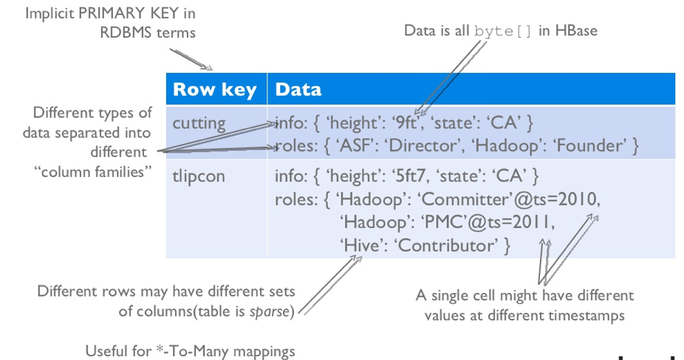
HBase Logical View

Slide 10
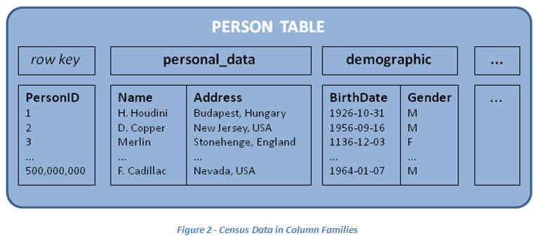
HBase: Keys and Column Families
Each record is divided into Column Families
Each row has a Key
Each column family consists of one or more Columns

Slide 11
Column family named “anchor”
Column family named “Contents”
Key
Byte array
Serves as the primary key for the table
Indexed far fast lookup
Column Family
Has a name (string)
Contains one or more related columns
Column
Belongs to one column family
Included inside the row
familyName:columnName
Column named “apache.com”

Slide 12
Version number for each row
Version Number
Unique within each key
By default→ System’s timestamp
Data type is Long
Value (Cell)
Byte array
value

Slide 13
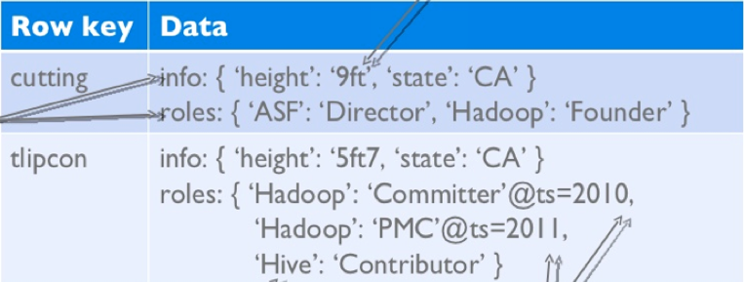
Notes on Data Model
HBase schema consists of several Tables
Each table consists of a set of Column Families
Columns are not part of the schema
HBase has Dynamic Columns
Because column names are encoded inside the cells
Different cells can have different columns
“Roles” column family has different columns in different cells

Slide 14
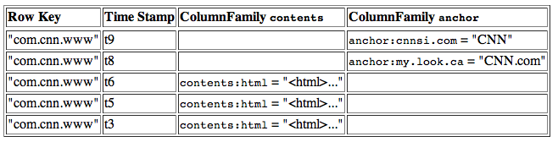
Notes on Data Model (Cont’d)
The version number can be user-supplied
Even does not have to be inserted in increasing order
Version number are unique within each key
Table can be very sparse
Many cells are empty
Keys are indexed as the primary key
Has two columns
[cnnsi.com & my.look.ca]

Slide 15
HBase Physical Model

Slide 16
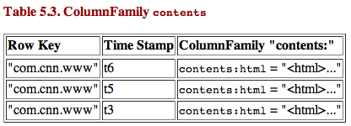
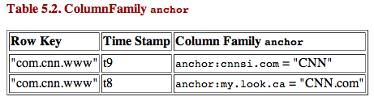
HBase Physical Model
Each column family is stored in a separate file (called HTables)
Key & Version numbers are replicated with each column family
Empty cells are not stored
HBase maintains a multi-level index on values:
<key, column family, column name, timestamp>

Slide 17
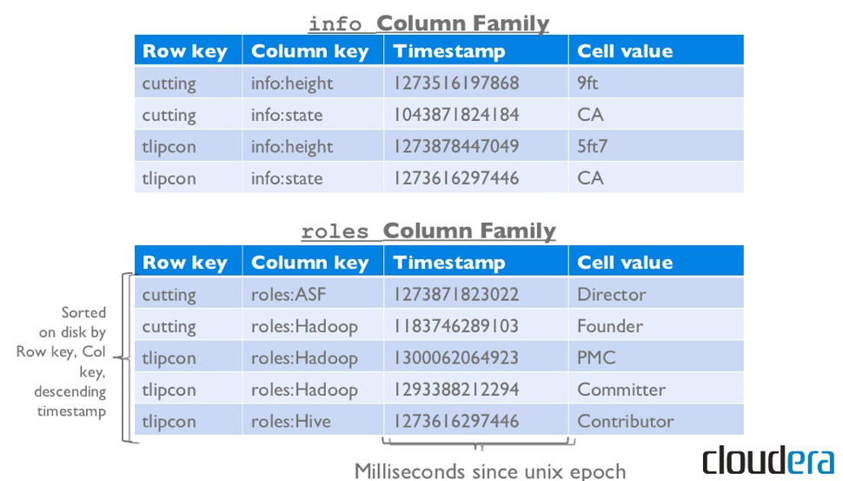
Example

Slide 18
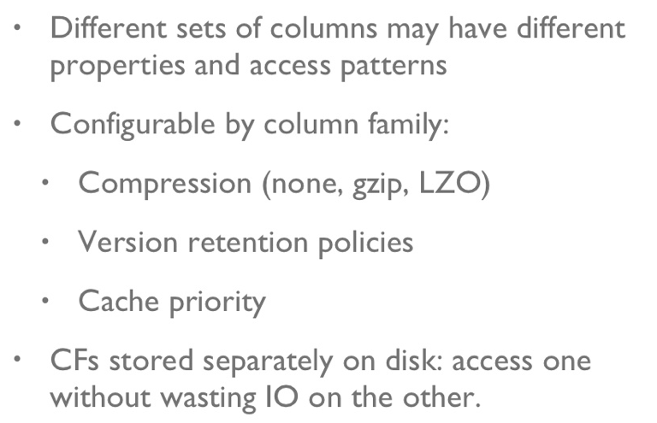
Column Families

Slide 19
HBase Regions
Each HTable (column family) is partitioned horizontally into regions
Regions are counterpart to HDFS blocks
Each will be one region

Slide 20
HBase Architecture

Slide 21
Three Major Components
The HBaseMaster
One master
The HRegionServer
Many region servers
The HBase client

Slide 22
HBase Components
Region
A subset of a table’s rows, like horizontal range partitioning
Automatically done
RegionServer (many slaves)
Manages data regions
Serves data for reads and writes (using a log)
Master
Responsible for coordinating the slaves
Assigns regions, detects failures
Admin functions

Slide 23
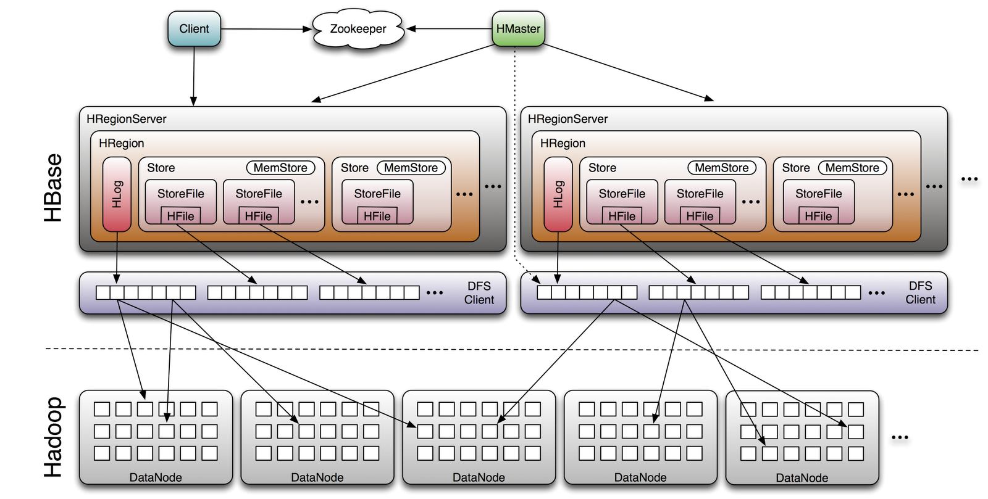
Big Picture

Slide 24
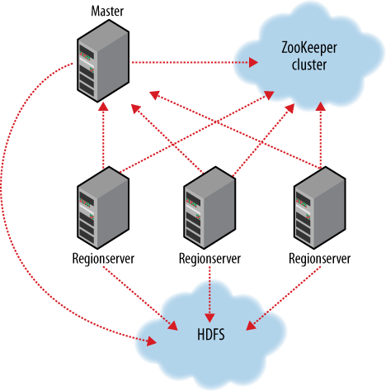
ZooKeeper
HBase depends on ZooKeeper
By default HBase manages the ZooKeeper instance
E.g., starts and stops ZooKeeper
HMaster and HRegionServers register themselves with ZooKeeper

Slide 25
Creating a Table
HBaseAdmin admin= new HBaseAdmin(config);
HColumnDescriptor []column;
column= new HColumnDescriptor[2];
column[0]=new HColumnDescriptor("columnFamily1:");
column[1]=new HColumnDescriptor("columnFamily2:");
HTableDescriptor desc= new HTableDescriptor(Bytes.toBytes("MyTable"));
desc.addFamily(column[0]);
desc.addFamily(column[1]);
admin.createTable(desc);

Slide 26


Operations On Regions: Get()
Given a key → return corresponding record
For each value return the highest version
Can control the number of versions you want

Slide 27
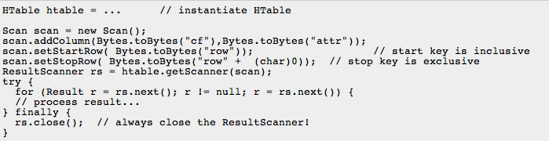
Operations On Regions: Scan()

Slide 28

Get()
Select value from table where key=‘com.apache.www’ AND label=‘anchor:apache.com’
Row key | Time Stamp | Column “anchor:”
“com.apache.www” | t12
 | t11
 | t10 | “anchor:apache.com” | “APACHE”
“com.cnn.www” | t9 | “anchor:cnnsi.com” | “CNN”
 | t8 | “anchor:my.look.ca” | “CNN.com”
 | t6
 | t5
 | t3

Slide 29
Scan()
Select value from table where anchor=‘cnnsi.com’
Row key | Time Stamp | Column “anchor:”
“com.apache.www” | t12
 | t11
 | t10 | “anchor:apache.com” | “APACHE”
“com.cnn.www” | t9 | “anchor:cnnsi.com” | “CNN”
 | t8 | “anchor:my.look.ca” | “CNN.com”
 | t6
 | t5
 | t3

Slide 30


Operations On Regions: Put()
Insert a new record (with a new key), Or
Insert a record for an existing key
Implicit version number
(timestamp)
Explicit version number

Slide 31
Operations On Regions: Delete()
Marking table cells as deleted
Multiple levels
Can mark an entire column family as deleted
Can make all column families of a given row as deleted
All operations are logged by the RegionServers
The log is flushed periodically

Slide 32
HBase: Joins
HBase does not support joins
Can be done in the application layer
Using scan() and get() operations

Slide 33
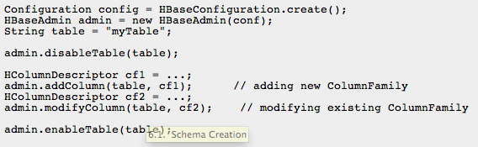
Altering a Table
Disable the table before changing the schema

Slide 34
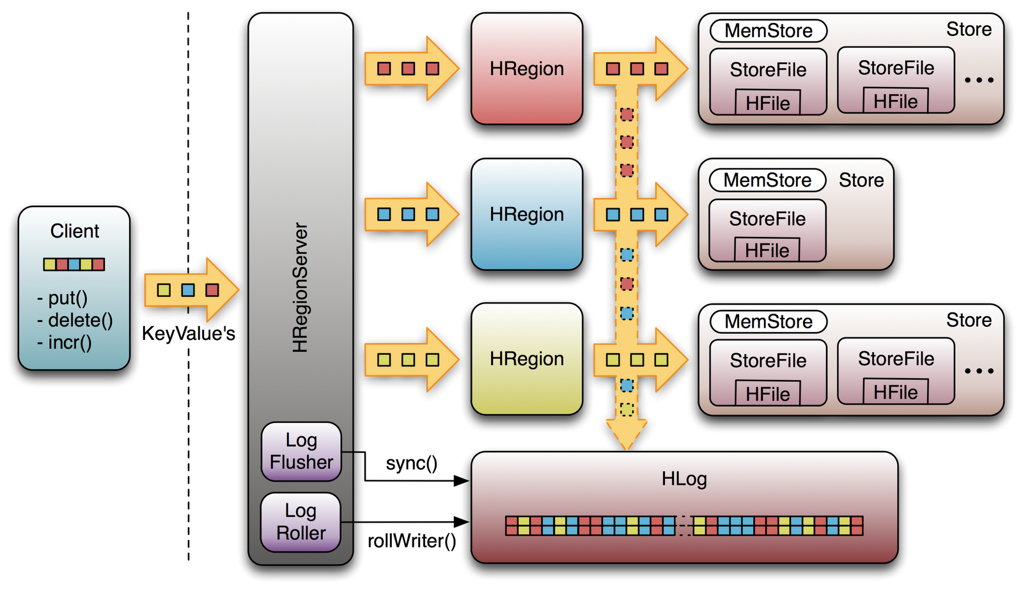
Logging Operations

Slide 35
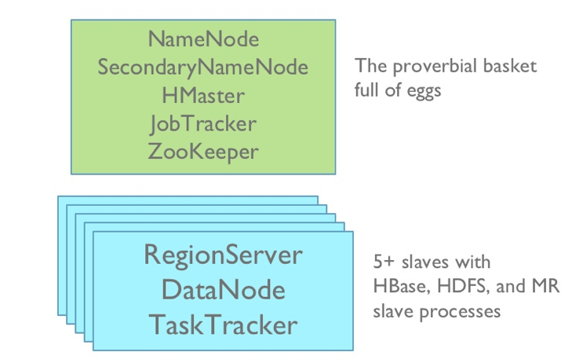
HBase Deployment
Master
node
Slave
nodes

Slide 36
HBase vs. HDFS

Slide 37
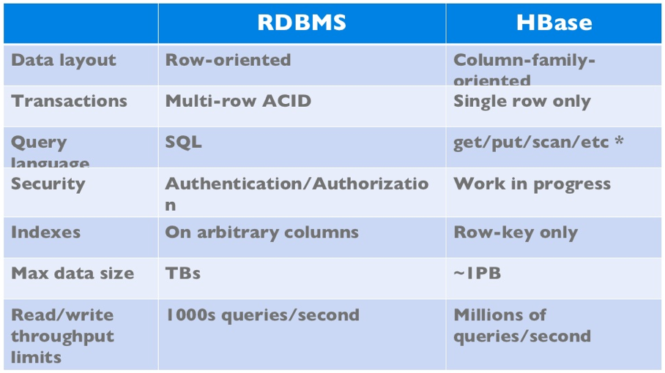
HBase vs. RDBMS

Slide 38
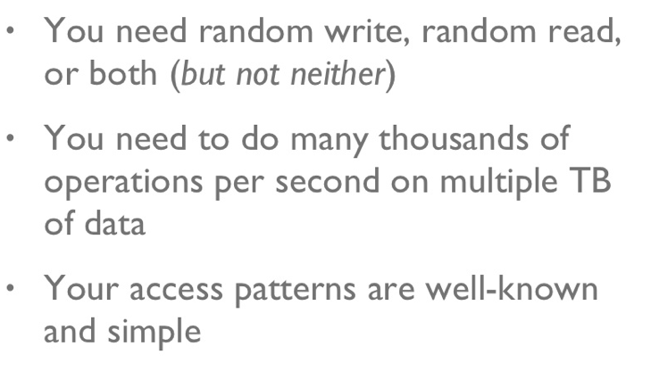
When to use HBase

